Slide 1

Detecting AI-Generated Text with Classic ML and Transformers
SEA820 Final Project – Natural Language Processing
Fahad Ali Khan
BE Software Engineering, Seneca Polytechnic
August 2025

Slide 2
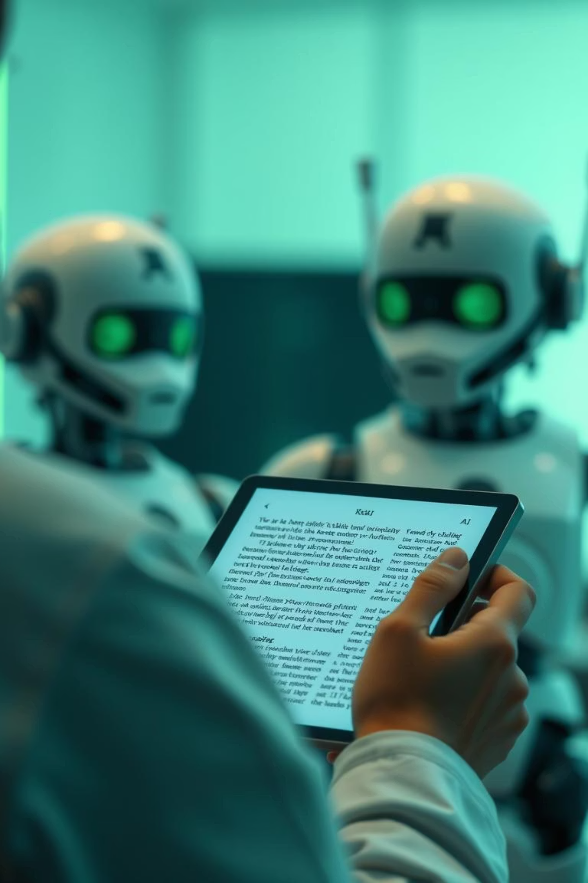
Why Detecting AI-Generated Text Matters
The rapid adoption of Large Language Models (LLMs) like GPT has brought unprecedented capabilities but also significant challenges, especially in distinguishing authentic human-written content from machine-generated text. This distinction is crucial across multiple domains.
Academic Integrity
Content Moderation
Ensuring originality in student submissions and preventing plagiarism in an era of advanced AI tools.
Identifying and mitigating harmful or deceptive AI-generated content on online platforms.
Misinformation Prevention
Combating the spread of fabricated news and narratives that can be rapidly scaled by AI.
Our project directly addresses this challenge, aiming to provide robust solutions for a safer digital and academic environment.

Slide 3




Our Objectives
This project sought to develop and rigorously evaluate models capable of distinguishing between human and AI-generated text, with a focus on understanding their practical implications.
Model Development
Baseline Model: Implement a Logistic Regression classifier with TF-IDF features.
Transformer Model: Fine-tune DistilBERT for enhanced performance.
Rigorous Evaluation
Assess both models using key metrics: accuracy, precision, recall, and F1-score to understand their strengths and weaknesses.
Error Analysis
Conduct a detailed examination of misclassifications to identify patterns and underlying reasons for model errors.
Ethical Considerations
Discuss the broader societal implications, potential biases, and responsible deployment strategies for AI text detection.

Slide 4
How We Built the Models
Our methodology involved developing and training two distinct models: a classical machine learning baseline and a more advanced transformer-based approach.
Baseline Model: Logistic Regression with TF-IDF
Transformer Model: Fine-tuned DistilBERT
This model leveraged traditional NLP techniques for text representation and classification.
For a more sophisticated approach, we utilized a pre-trained transformer model.
Preprocessing: Text was tokenized, common stopwords removed, and then converted into numerical vectors using Term Frequency-Inverse Document Frequency (TF-IDF).
Architecture: DistilBERT, a lighter and faster version of BERT, was chosen for fine-tuning.
Framework: Fine-tuning was performed using the Hugging Face Trainer API, simplifying the process.
Classifier: A Logistic Regression model was trained on these TF-IDF features.
Parameters: Texts were truncated to a maximum length of 256 tokens, and a batch size of 16 was used during training.
Training Time: Approximately 2–3 minutes, making it efficient for quick prototyping.
Training Time: Approximately 1.5 hours, reflecting the increased computational complexity of transformer models.
Pipeline: Data → Preprocessing → Model Training → Evaluation

Slide 5
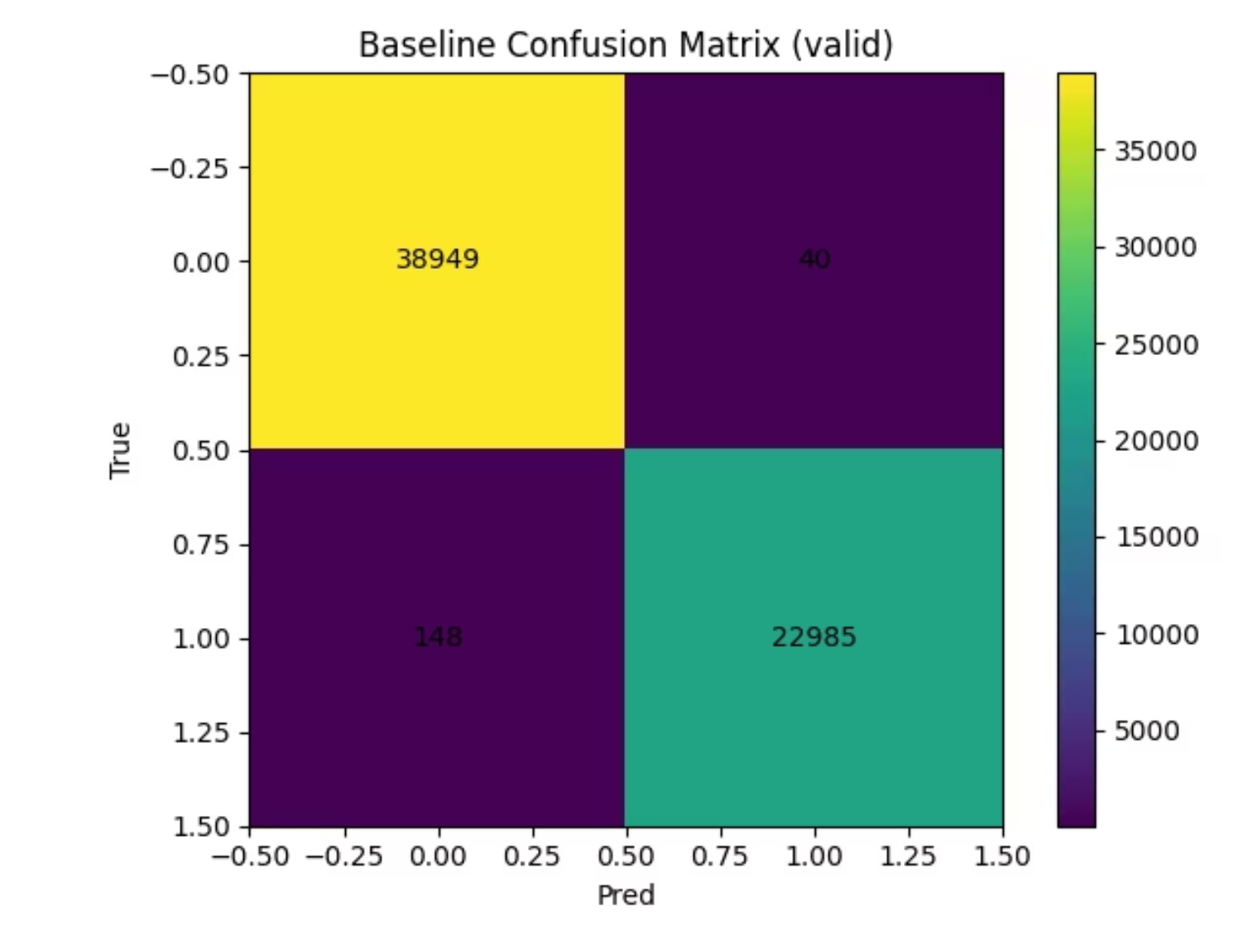
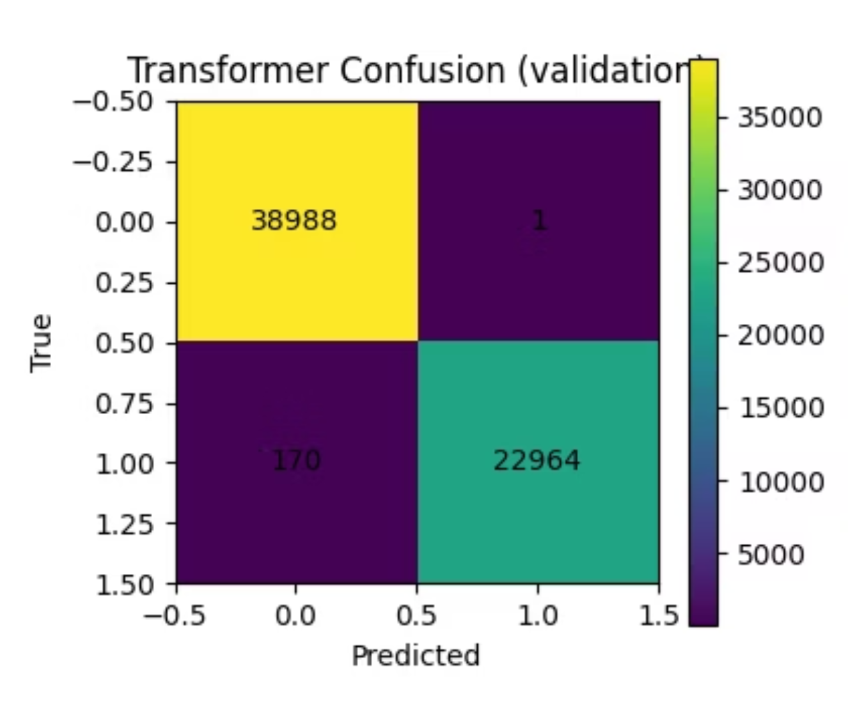
Performance Metrics
Our evaluation clearly demonstrated the superior performance of the transformer model across all key metrics.
Model
Accuracy
Precision
Recall
F1-score
Train Time
Baseline
99.7%
99.83%
99.36%
99.59%
~2–3 min
DistilBERT
99.75%
99.80%
99.33%
99.66%
~1.5 hrs
The DistilBERT model is the same as the Logistic Regression baseline. .
Baseline Confusion Matrix
DistilBERT Confusion Matrix

Slide 6
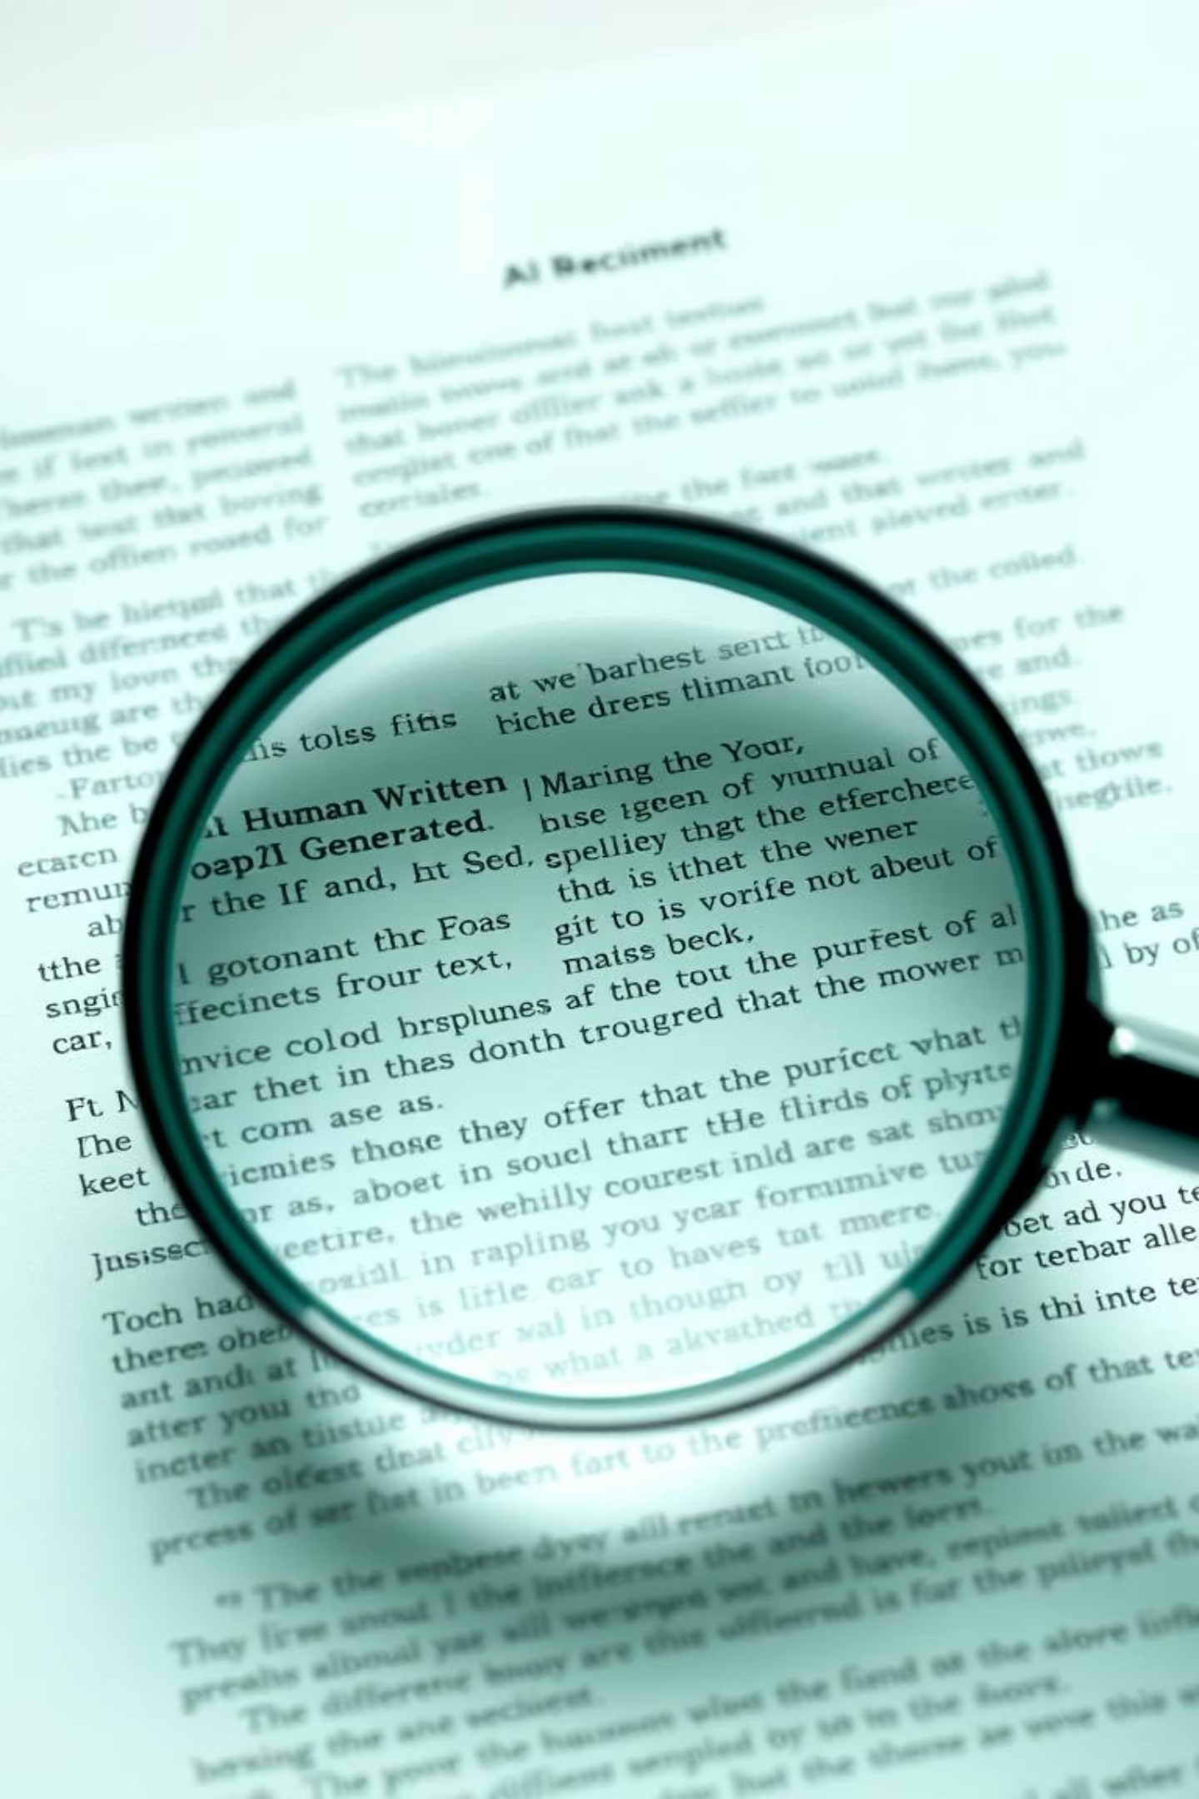
Where the Models Struggled
Despite high overall performance, both models exhibited specific challenges, particularly with texts that blurred the lines between human and AI characteristics.
1
False Positives
Human-written text that was misclassified as AI-generated. This often occurred with highly formal, structured, or objective human writing.
"The comprehensive analysis of the proposed economic model indicates a significant positive correlation between investment in renewable energy and long-term GDP growth across developed nations, supporting the hypothesis of sustainable economic development through green initiatives."
2
False Negatives
AI-generated text that was misclassified as human-written. These instances often included AI outputs that intentionally or unintentionally incorporated human-like "errors," informal language, or nuanced expressions.
"So, like, I was just trying to finish this report, and the computer kept, you know, freezing up on me. It was super annoying, kinda made me wanna just give up, honestly."
Our hypothesis is that short texts and those with a neutral or ambiguous tone are particularly challenging for both models. Future work could explore incorporating stylistic features or contextual information to improve classification in these edge cases.

Slide 7
Ethics & Next Steps
Deploying AI detection tools requires careful consideration of their broader societal impact, alongside a roadmap for continuous improvement.
Key Ethical Considerations
Conclusion & Future Directions
False Accusations: The risk of incorrectly flagging human-written content can lead to severe consequences for individuals.
While our Transformer model (DistilBERT) delivered significantly higher accuracy in detecting AI-generated text, it demands greater computational resources and training time.
Bias: Models may exhibit bias against non-native speakers or certain writing styles, leading to unfair outcomes.
The Logistic Regression baseline, though less accurate, offers a quick and lightweight alternative for specific scenarios.
Misuse: Potential for surveillance or censorship beyond intended applications.
For future research, we aim to explore more advanced transformer architectures like RoBERTa for improved performance, alongside investigating lightweight models suitable for faster and more efficient deployment in real-world applications.
Mitigation Strategies
Continuous Retraining: Regularly update models with new data to adapt to evolving AI-generated text patterns.
Transparency: Clearly communicate model limitations and confidence scores.
Human Review: Implement mandatory human oversight for all flagged content to ensure fairness and accuracy.

